Slide 1
Using Machine Learning Techniques to Predict Purchase by Customers Based on Dynamic Pricing
Presented By:
Bharkavi Sachithanandam
Lohith Nagaraja

Slide 2
Agenda
Motivation
Dataset Description
Data Preprocessing
Clustering
Dynamic Price Determination
Classification Algorithms
Results
Future Work
Conclusion

Slide 3
Motivation - Dynamic Pricing
Have you ever noticed this?
Most of the Grocery Products do not have a Marked Retail Price(MRP)

Slide 4
Motivation - Dynamic Pricing
Gives rise to the Business Questions
How to determine the ideal price for a customer?
Given an ideal price, would the customer buy if a product is available in that price?

Slide 5
Motivation - Dynamic Pricing
The Solution is
Group the customers based on their Previous purchase history
Determine a price for each group using Statistical Methods
Train a model to determine if given the price, will a customer buy the product or not!

Slide 6
DataSet Description
Source - Kaggle Competition - Acquire Valued Shoppers Challenge
Transactions.csv - Contains the transaction history of each customer over a year.
History.csv - Contains incentive details and purchase outcome of the customer.
Offers.csv - Contains details about the incentives.
This was a Huge dataset and needed 22GB once uncompressed.
Transactions.csv had 350 Million samples with 300,000 unique customers.
History.csv had 2300 unique samples.

Slide 7
Data Preprocessing
Transactions and History Datasets too huge to be processed.
History dataset had unique samples
Based on the customer IDs present in the History dataset, Transactions dataset was processed in chunks parallely.
Purchase Metrics like Total Purchase amount, total quantity purchased by the customer, Price per quantity, purchase done for a brand, are derived .

Slide 8
Clustering - K-Means Clustering
Unsupervised machine learning algorithm
Groups similar data points together in a dataset.
Partitions the data into K clusters,
where K is a predefined number of clusters.
Algorithm randomly selects K data points from the dataset as the initial centroids of the clusters
Then iteratively assigns each data point to the nearest centroid
Recalculates the centroids of each cluster until convergence.

Slide 9
Clustering
So based on Purchase amount, quantity and other purchase metrics, Customers are grouped into 4 Clusters using K-Means Clustering Algorithm.
Cluster No. | No. of Data points
0 | 231
1 | 778
2 | 1084
3 | 207

Slide 10
Dynamic Price Determination
There are various methods -
Rule-based pricing - time of day, week, demand level.
Machine Learning - using algorithms based on demand, real-time activity of users, competitor prices, demographic information,etc.
Statistical methods - using mean/median of customer purchase amount from transaction history as a method of determining the price of the product.

Slide 11
Dynamic Price - Statistical Approach
Our dataset did not have information on the product demand, competitor prices, or real-time activity data. Hence, we chose a statistical approach.
For each cluster of users, dynamic price was set as the mean of purchase amount of all the users in the cluster.
The determined dynamic price represents the purchase power of cluster.

Slide 12
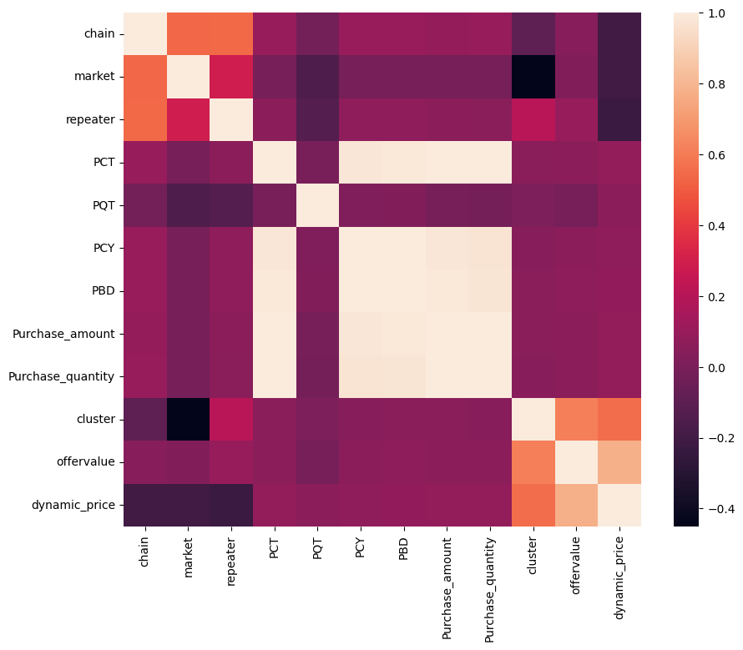
Heat Map

Slide 13
Purchase Prediction using Machine Learning
We used RFE to select 7 features with highest covariance with the target variable.
The following models were used:
Logistic Regression
Decision Trees
Random Forest
XGBoost
Support Vector Machines (SVMs)
Stratified K-fold for training to preserve the percentage of samples for each class. This also ensured that there were no unlucky splits.

Slide 14
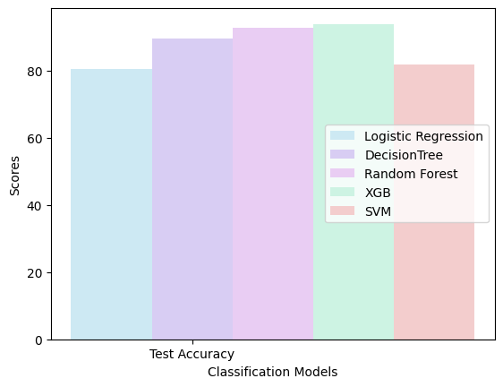
Results

Slide 15
Results
Model | Accuracy | Precision | Recall | F1 Score | Confusion Matrix
Logistic Regression | 0.80 | 0.84 | 0.76 | 0.80 | [ [192 33] [ 57 178] ]
Decision Trees | 0.89 | 0.87 | 0.91 | 0.90 | [ [198 27] [ 21 214] ]
Random Forest | 0.92 | 0.96 | 0.89 | 0.92 | [ [218 7] [ 26 209] ]
XGBoost | 0.94 | 0.97 | 0.90 | 0.94 | [ [220 5] [ 23 212] ]
SVM | 0.81 | 0.90 | 0.72 | 0.80 | [ [208 17] [ 66 169] ]

Slide 16
Conclusion
Dynamic pricing has become an increasingly popular technique for businesses to optimize their pricing strategy and increase revenue.
Machine learning algorithms can be used to analyze large amounts of data in real-time and predict customer behavior and purchase patterns.
By using dynamic pricing, businesses can offer personalized pricing based on a variety of factors, such as customer demographics, product demand, and competitor pricing.
Overall, by using dynamic pricing and machine learning algorithms, businesses can gain a competitive edge and increase their revenue while also providing value to their customers.

Slide 17
Future work
We can consider more factors such as social media data, customer reviews, demand, purchase patterns, and product ratings to set dynamic prices.
Future research can evaluate the impact of dynamic pricing on customer behavior, including factors such as purchase frequency, loyalty, and overall satisfaction.
Analyzing data real-time will provide a more accurate dynamic pricing models.

Slide 18
THANK YOU

